Slide 1
Recommendations Service

Slide 2
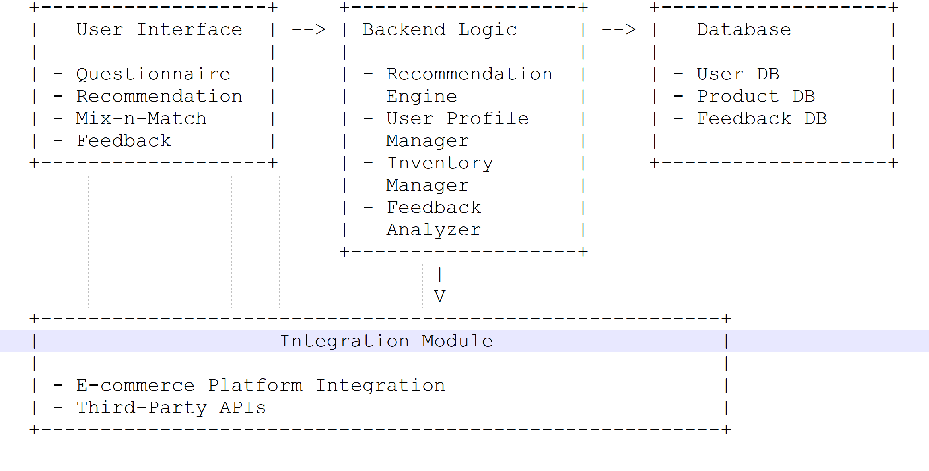
Architecture Diagram

Slide 3
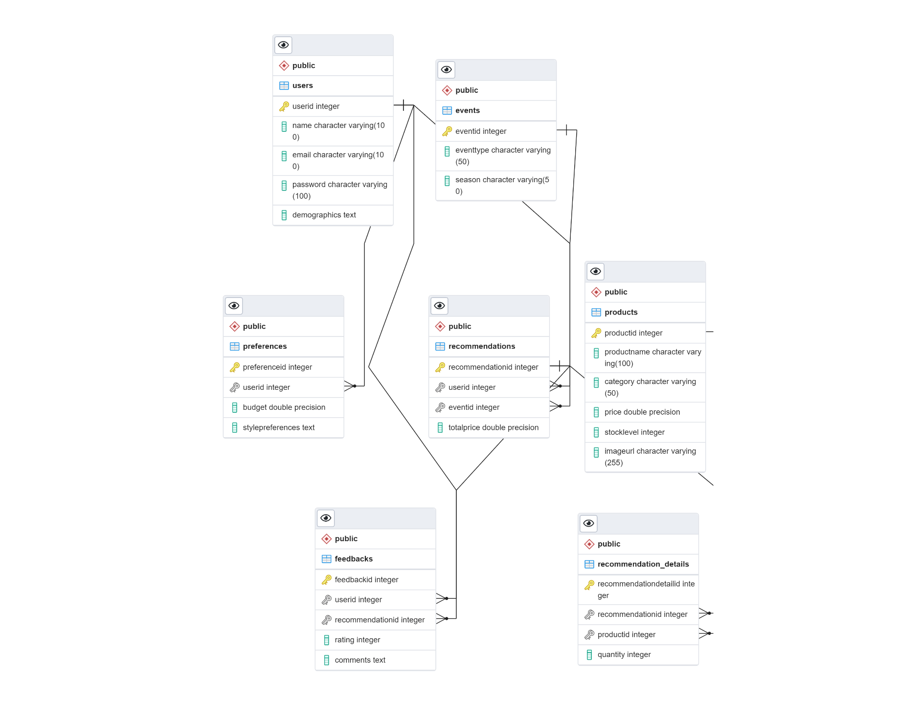
ERD Diagram

Slide 4
Wireframe Sketches

Slide 5
Home Page
Welcome to Your Personalized Outfit Recommendation
Start Now

Slide 6
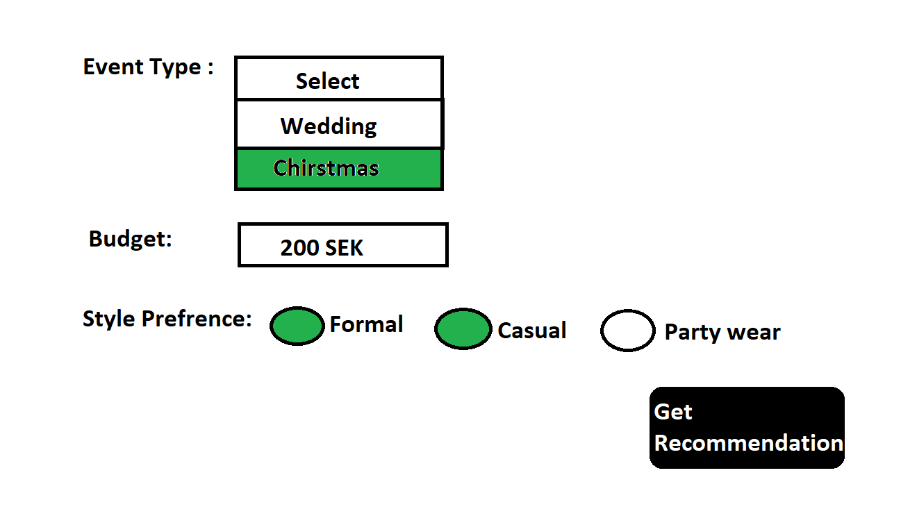
User Input Page
Tell Us About Your Event
Next
Get Recommendations

Slide 7
Recommendation Page
Recommended Outfit
Outfit Name | Style | Price | Image
Jacket | Casual | 150 | Jacket Image
Shirt | Casual | 60 | Shirt Image
Trousers | Casual | 10 | Trousers Image
Boots | Formal | 90 | Boots Image
Add to Cart
Mix-n-Match

Slide 8
Mix-n-Match Page
Customize Your Outfit
Outfit Name | Image | Price | Update Items
Jacket | Jacket Image | 150 | Change Item
Shirt | Shirt Image | 60 | Change Item
Trousers | Trousers Image | 10 | Change Item
Boots | Boots Image | 90 | Change Item
Update Cart

Slide 9
Checkout Page
Review Your Selections
Outfit Name | Image | Price
Jacket | Jacket Image | 150
Shirt | Shirt Image | 60
Trousers | Trousers Image | 10
Boots | Boots Image | 90
Proceed to Payment

Slide 10
Payment Page
Payment Gateway Integration Page

Slide 11
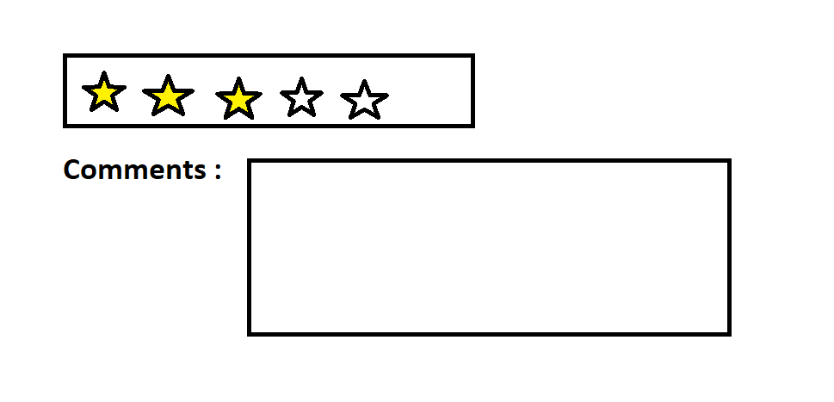
Feedback Page
Rate Your Recommendation
Submit Feedback

Slide 12
Thank you

